Slide 1
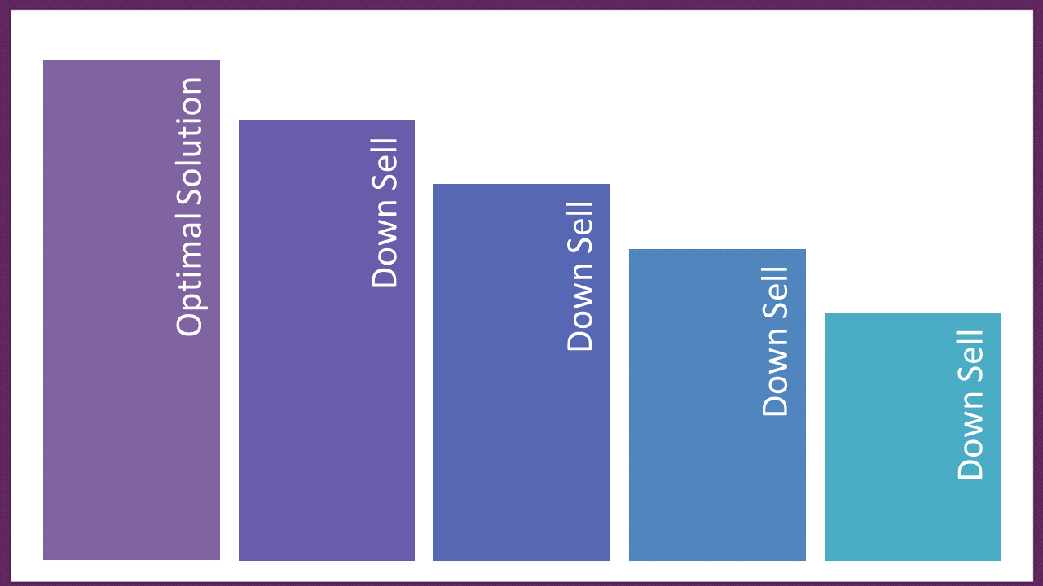
Begin with the end in mind
The OPTIMAL SOLUTION
Your
Best
& Most
Robust
Parts of
Optimal
Less Parts
Highest
Biggest
Medium High to Medium
Medium to
Medium Low
Low to Free
Even Less
Least

Slide 2
Planning from Your Funnel

Slide 3

January | February | March
April | May | June
July | August | September
October | November | December

