Slide 1


Content Creation Made Easy
(Roadmap)
Your Step-by-Step Roadmap for Sharing Your Content to Create Engagement and Attract Quality Leads

Slide 2

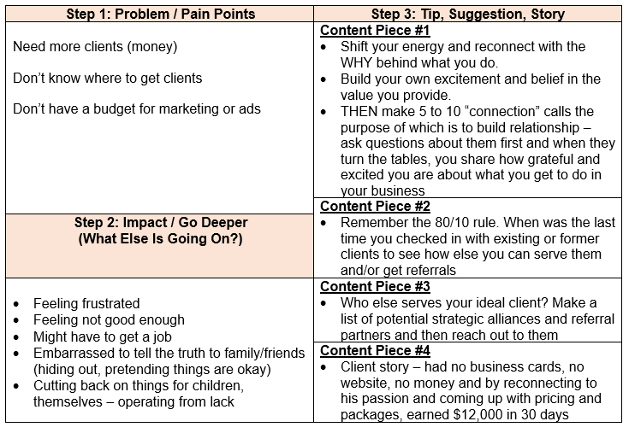
Content Piece #1
Write a blog post then share to your PERSONAL FB page
Then – share from personal FB profile to FB Group & FB page (if you have one)
Content Piece #2
Do a video (FB Live if you’re up for it). Put this FIRST in your FB Business Page or Group – then share to your personal profile
Content Piece #3
Do a video (FB Live if you’re up for it). Put this FIRST in your FB Business Page or Group – then share to your personal profile
Content Piece #4
Share a client testimonial picture or story on social media .. “Beyond grateful that this is what I get to do.”

Slide 3

Content #1
Note: if you don’t have website,
Just write as a long post on your personal profile
Share Blog on Personal FB Profile
Blog on your website
FB Business Page
& FB Group
Share to your personal FB Profile
FB Live on your FB Business Page
Facebook Group and/or to your website blog
Content #2
Share to Facebook Page and/or group
FB Live on your personal profile
Post to your website/blog
Content #3
Share to personal FB profile and/or page
Post in Facebook Group
Content #4
Post to your website/blog
Facebook is used as the example and remember, you can also repurpose the content to other platforms in the same fashion such as LinkedIn, YouTube, Instagram posts and IG Live, Twitter, Pinterest, etc.

