Slide 1

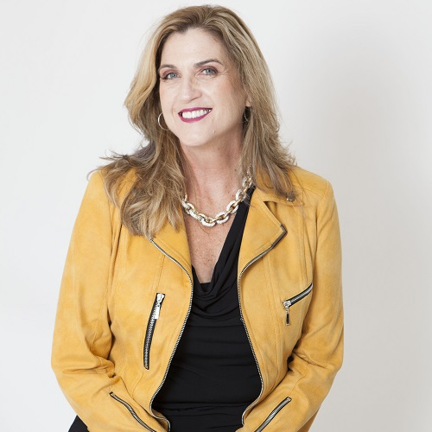
Meet Today’s Featured Platinum Member
Areas of Expertise:
Sales, Marketing & Leadership Expert
Consultant, Speaker & Author
Passions:
Family, Music (Rock ‘n Roll), Always Learning, Being The One
Favorite Quote:
“People will forget what you said. People will forget what you did, but they will never forget how you made them feel.” ~ Maya Angelou
Nancy Matthews
Website ► NancyMatthews.com
Example

Slide 2
Meet Today’s Featured Platinum Member
PUT YOUR PICTURE HERE
Areas of Expertise:
___________________
Passions:
______________________
Favorite Quote:
___________________________
Replace with Your Name
Website ► YourWebsite

