Slide 1
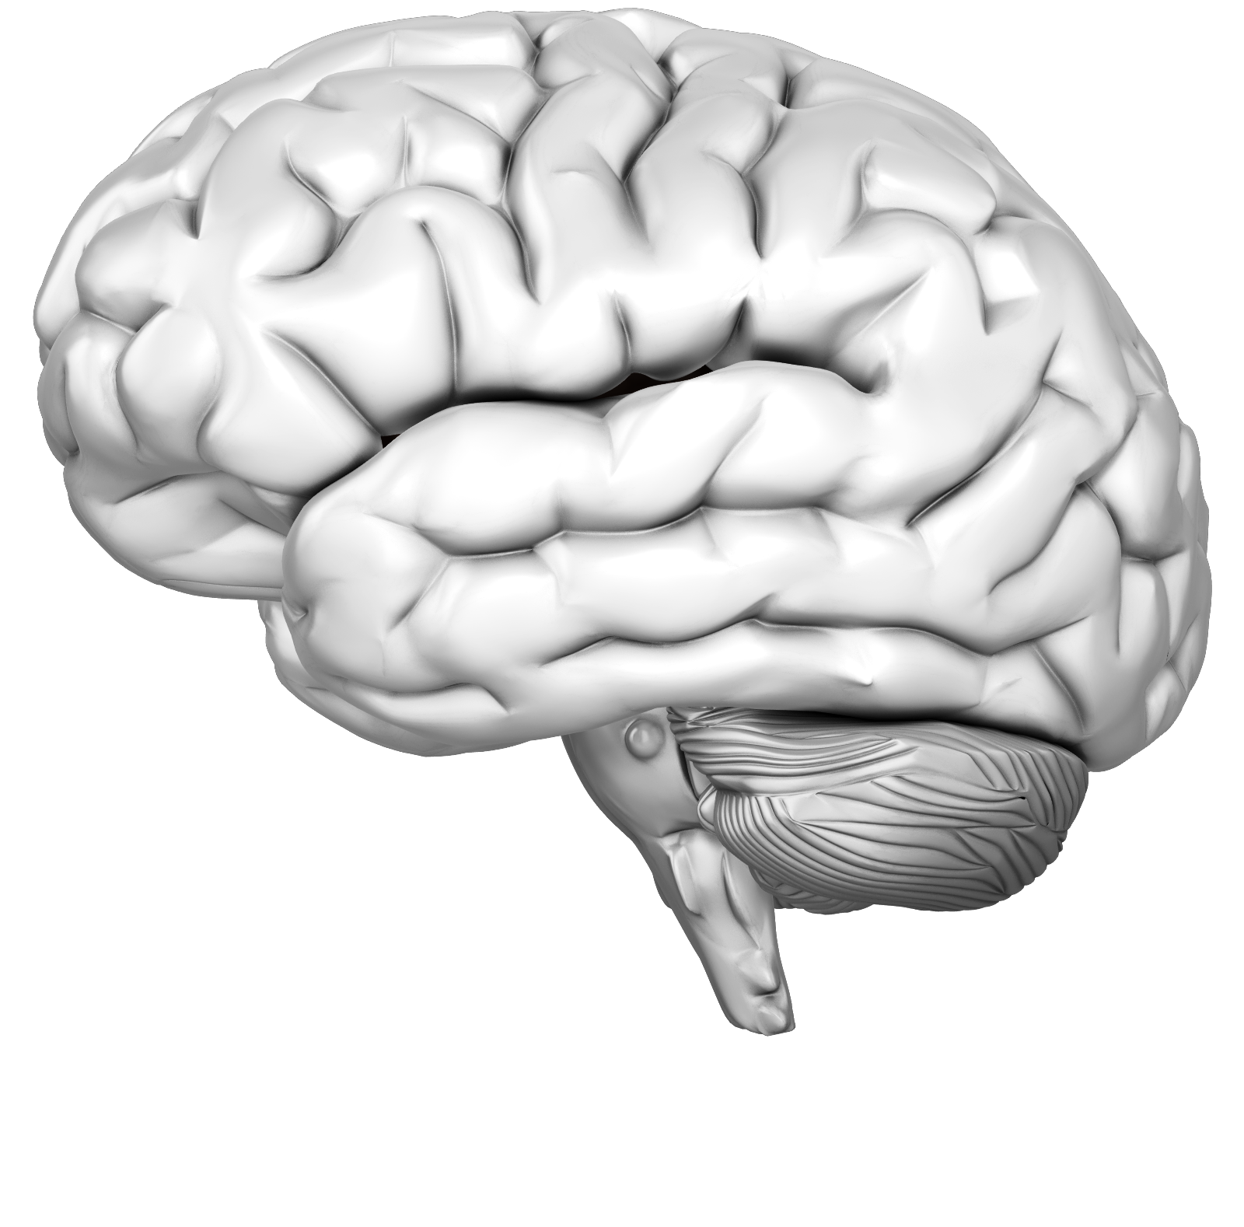
Brain Dump!

Slide 2
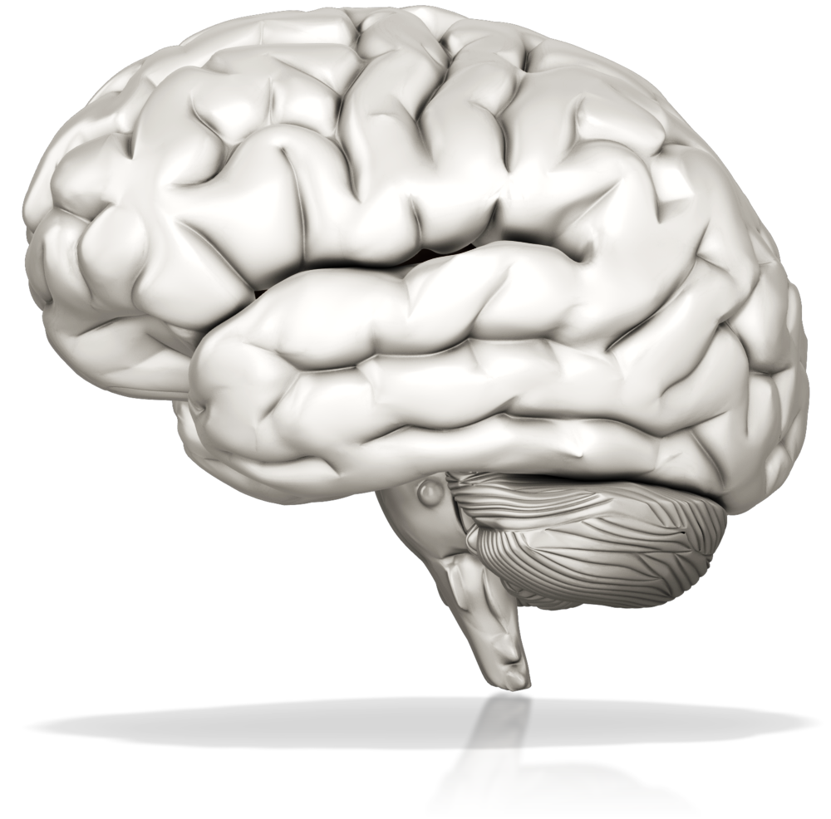
Next Step
Here
Next Step
Here
Next Step
Here
Next Step
Here
Next Step
Here
Next Step
Here
Next Step
Here
Next Step
Here
Next Step
Here
Your
Vision
Fulfilled
Next Step
Here
Next Step
Here
Next Step
Here
Brain Dump – All the Pieces to Fulfill Your Vision

Slide 3
Brain Dump – All the Pieces to Fulfill Your Vision

Slide 4
Next Step
Here
Next Step
Here
Next Step
Here
Next Step
Here
Next Step
Here
Next Step
Here
Next Step
Here
Next Step
Here
Next Step
Here
Your
Vision
Fulfilled
Next Step
Here
Next Step
Here
Next Step
Here
Select the 4 “Big Chunk” Milestones from Your List

Slide 5
Milestone 1
Next Step
Here
Next Step
Here
Milestone 4
Next Step
Here
Next Step
Here
Milestone 2
Next Step
Here
Milestone 3
Your
Vision
Fulfilled
Next Step
Here
Next Step
Here
Next Step
Here
Brain Dump – All the Pieces to Fulfill Your Vision

Slide 6
Sub Branch
Sub Branch
Sub Branch
Sub Branch
Sub Branch
Sub Branch
Milestone 2
Here
Milestone 1
Here
Sub Branch
Your Vision
Sub Branch
Sub Branch
Milestone 3
Here
Milestone 4
Here
Sub Branch
Sub Branch
Sub Branch
Mission-Focused Sequencing

Slide 7
2
1
Your Vision
3
4
Mission-Focused Sequencing

Slide 8
Craft Your Personal Mission Statement
Who do I need to be everyday for the consistent embodiment and fulfillment of my Vision?
Vision:
A world where everyone treats each other as “The One.”
Every day I appreciate, educate and elevate.

Slide 9
Craft Your Personal Mission Statement
Who do I need to be everyday for the consistent embodiment and fulfillment of my Vision?
Your Vision:
______________________________________________
Your Mission Statement: _________________________________________

